Slide 1

Credit Data Analysis
Johnson varughese

Slide 2
Mission
Solve Credit one default issue with default prediction using data analysis.
Give a method to understand how much credit to allow someone to use to minimize loan default.

Slide 3
Data Science Framework
How to tackle the credit default issue at credit one

Slide 4
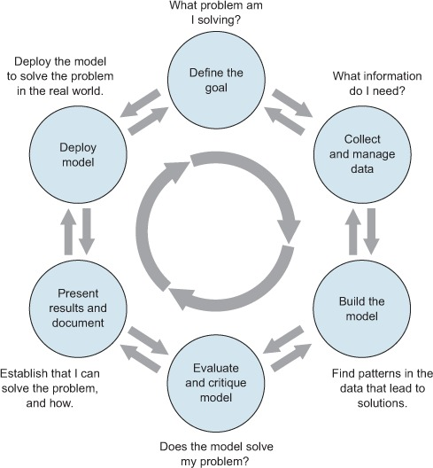
Process

Slide 5
Step 1: Frame the problem
Credit One has seen an increase in the number of customers who have defaulted on loans they have secured from various partners, and Credit One, as their credit scoring service, could risk losing business if the problem is not solved right away.

Slide 6
Step 2: Collect the raw data needed for the problem
Client has provided historical data about their customers credit use.

Slide 7
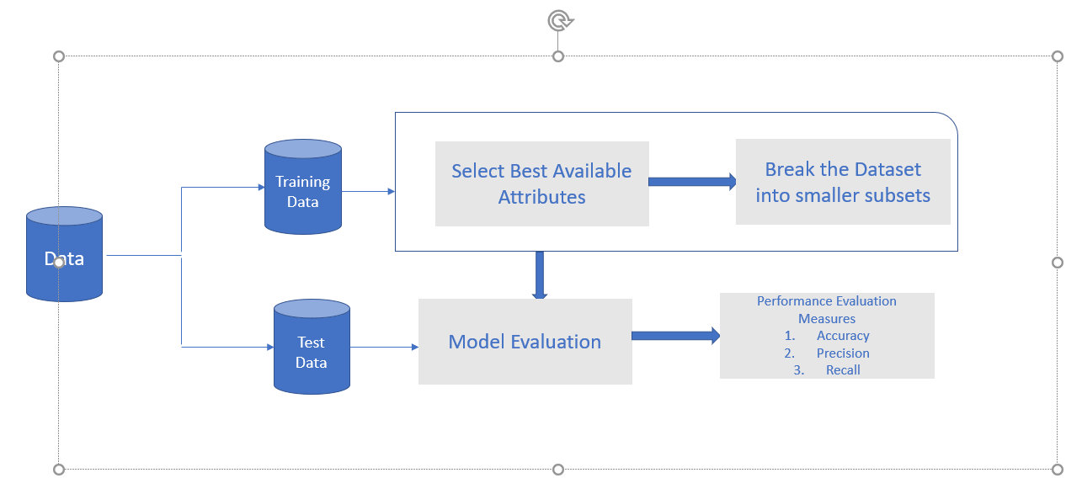
Decision Tree

Slide 8
Step 3: Process the data for analysis
Check the data following common errors:
Missing values, perhaps customers without enough information
Corrupted values, such as invalid entries
Date range errors, perhaps the dates that makes no sense, such as data registered from before loans originated.
Outliers can be removed, and partially missing data can be substituted with reasonable values.
Convert string data to integer values accordingly.

Slide 9
Step 4: Explore the data
Look at some of the most interesting patterns that can help explain why some customers defaulted their loans, may be they didn’t have enough earning potential to pay off the loan based on their education. May be their loan amount is too high for them to be qualified for.

Slide 10
Step 5: Perform in-depth analysis
In this process apply statistical, mathematical and technological knowledge and leverage all of the data science tools to crunch the data and find every possible insight.

Slide 11
Step 6: Communicate results of the analysis
Prepare and communicate the details of the insights uncovered from the data. Give concrete solutions that address the problem.

